Slide 1
Lecture 11: Positive vs. Normative Methods and their Role in Environmental Economics
Prof. Austin
Environmental Economics Econ 475

Slide 2
Module 3: Environmental Regulatory Impact Analysis
Roadmap for this module:
Positive and normative methods
Benefit cost analysis
Environmental Justice history and analysis
Purpose: Provide a framework for evaluating environmental policies that synthesizes economic tools with institutional and contextual factors. The goal of this module is to better understand the role of economics in evaluating regulations and public policy.

Slide 3
Part 1: Foundations

Slide 4
Refresher on Positive and Normative
The terms positive and normative have a specific meaning in economics.
Positive statements describe the state of the world (i.e., what is). Positive statements are verifiable.
Example: The unemployment rate in the US is 3.8% in August 2023.
Normative statements describe how the world ought to be (i.e., what should be). Normative statements are not falsifiable or may be speculative.
Example: Current unemployment and under-employment is too high.
Some statements can combine both positive and normative elements.
Example: The construction of high-speed rail has positive net benefits, and so the public should invest more in connecting cities with high-speed rail.

Slide 5
Refresher on Positive and Normative
The terms positive and normative have a specific meaning in economics.
Positive statements describe the state of the world (i.e., what is). Positive statements are verifiable.
Example: The unemployment rate in the US is 3.8% in August 2023.
Normative statements describe how the world ought to be (i.e., what should be). Normative statements are not falsifiable or may be speculative.
Example: Current unemployment and under-employment is too high.
Some statements can combine both positive and normative elements.
Example: The construction of high-speed rail has positive net benefits, and so the public should invest more in connecting cities with high-speed rail.

Slide 6
Refresher on Positive and Normative
The terms positive and normative have a specific meaning in economics.
Positive statements describe the state of the world (i.e., what is). Positive statements are verifiable.
Example: The unemployment rate in the US is 3.8% in August 2023.
Normative statements describe how the world ought to be (i.e., what should be). Normative statements are not falsifiable or may be speculative.
Example: Current unemployment and under-employment is too high.
Some statements can combine both positive and normative elements.
Example: The construction of high-speed rail has positive net benefits, and so the public should invest more in connecting cities with high-speed rail.

Slide 7
Some Intellectual History
The distinction between positive and normative has deep roots in epistemology.
Auguste Comte and positivism:
Genuine knowledge consists of that which can be proven true through the scientific method or other logical reasoning.
Non-scientific modes of reasoning (e.g., intuition) do not produce worthwhile information.
Led to social sciences becoming more empirical and quantitative.
David Hume and the is-ought problem (a.k.a., the fact-value distinction).
Descriptions of how the world is cannot be used to argue for how the world should be without introducing a value judgement.

Slide 8
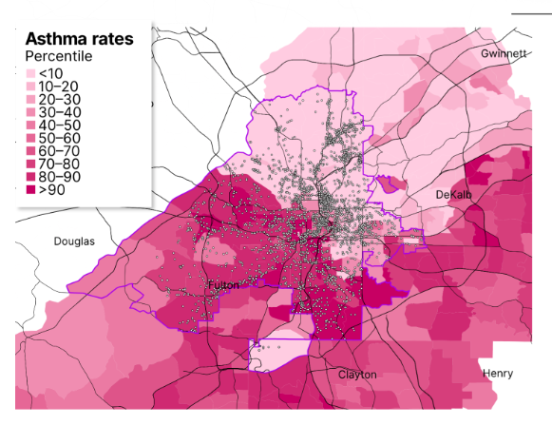

An Example to Motivate Discussion
Imagine that a policymaker is interested in turning a forest into a police training facility. Public funding is a constraint, and the policymaker also cares about public opinion and their constituency.
What are some positive and normative considerations that the policymaker will consider?
Image source.

Slide 9

An Example to Motivate Discussion
Brainstorm and list three normative and positive research questions or considerations related to the facility.
Image source.

Slide 10
An Example to Motivate Discussion
What are some positive and normative considerations that the policymaker will consider?
Brainstorm and list three normative and positive research questions or considerations.
Notes:
Examples of Positive Considerations
What are the costs and benefits of the facility to the city?
What are the impacts of the facility on local air and water quality?
Local opinion is opposed to the construction of the facility.
Examples of Normative Considerations
The police are already too militarized.
Local authorities have been heavy-handed in suppressing protests against the facility.
The training center will increase policy brutality.

Slide 11
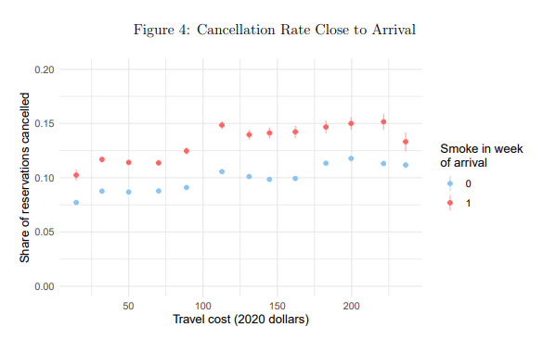

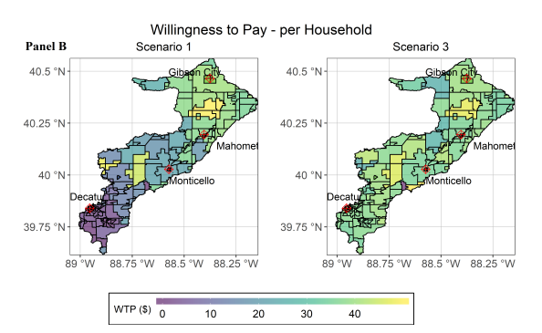
Economics as a Positive Discipline
“It’s positive economics where economists have both an absolute and comparative advantage over other disciplines.”
-- Paul Samuelson, Foundations of Economic Analysis
Economists combine theory, math, and data to test our understanding of environmental problems and answer novel research questions.
We have covered many positive research questions:
Plastic bags, bottled water purchases, wildfires, nutrient pollution, etc.

Slide 12
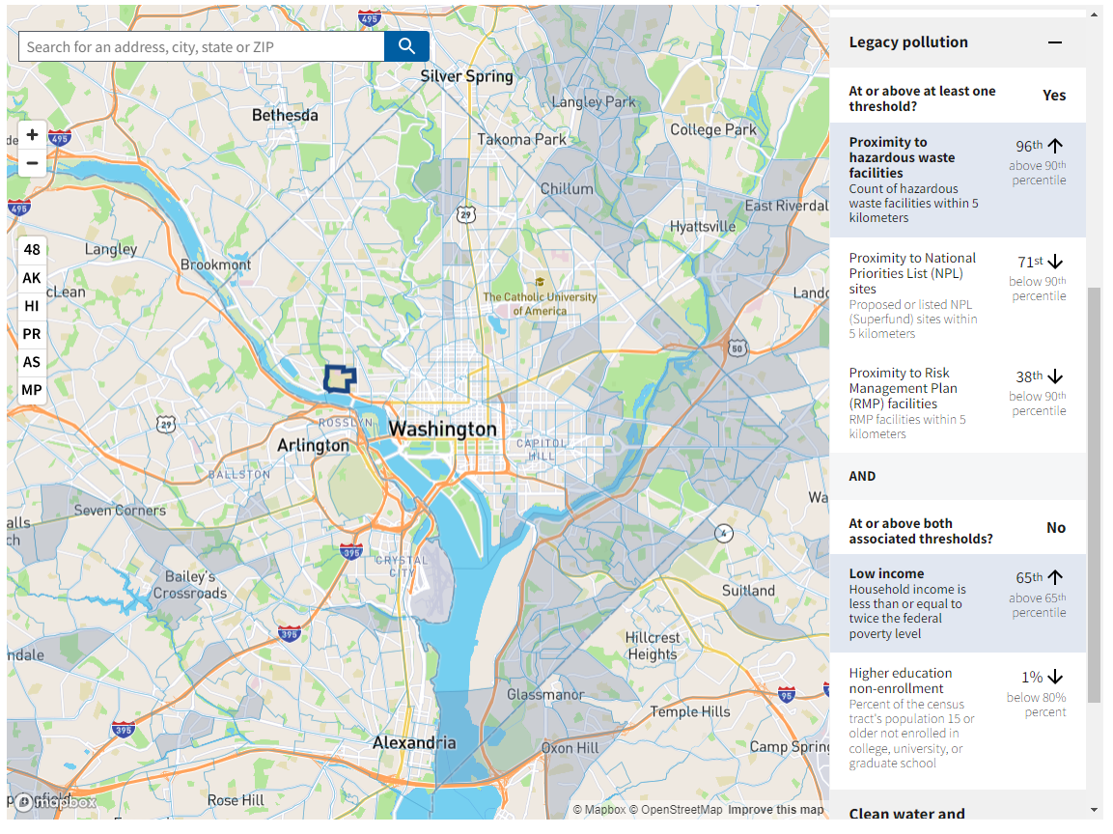
Normative Assertions in Environmental Policy
In 2022, the Center for Environmental Quality (CEQ) released a tool to help inform policy decisions related to the human-environment relationship
The Climate and Economic Justice Screening Tool (CEJST).

Slide 13

Normative Assertions in Environmental Policy
“…A tool that doesn’t explicitly account for race risks missing moderate-income communities of color that have nonetheless suffered from disproportionate impacts of pollution due to a history of racist land-use decisions — and bear the public health scars to go along with it.”
--- Sacoby Wilson, Baltimore Sun (2022)
Sacoby Wilson is a professor of Environmental Health and Engineering at UMD and director of the UMD Center for Community Engagement, Environmental Justice and Health.

Slide 14
The Economists Role in Decision-making
How can economics contribute to a policymakers understanding of the impacts of the example facility discussed earlier?
The binary categories of positive and normative are useful analytic constructs to help social scientists evaluate their considerations and formulate more relevant and defensible evidence.
Environmental economics can be used to answer quantitative research questions related to the facility.
Normative considerations have a role in helping identify research questions or suggesting limitations. Ultimately, policy decisions are normative.

Slide 15
Part 2: Nuance

Slide 16
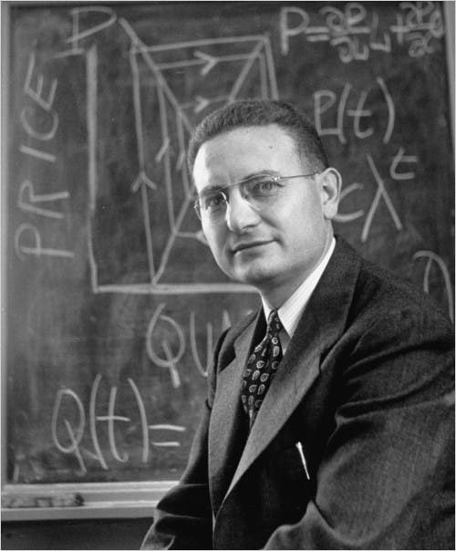
Economics as a Positive and a Normative Discipline
“It’s positive economics where economists have both an absolute and comparative advantage over other disciplines. Unfortunately, explaining “what is” satisfies neither the consumers of economics nor its producers.
“What should be” is an important issue, one that economists have not been able to resist.”
-- Paul Samuelson, Foundations of Economic Analysis
Paul Samuelson. Image source.

Slide 17
Is Economics a Purely Positive Science?
The distinction between positive and normative is not always as obvious as it may seem. Many positive statements have normative decisions embedded in them.
“The unemployment rate is 3.8%.”
The unemployment rate does not consider:
Stay-at home parents
Full-time students
Incarcerated individuals
Individuals not actively looking for employment
Individuals working at least 15 hours in gig jobs (i.e., Uber) are “employed.”
Source: Bureau of Labor Statistics.

Slide 18
Is Economics a Purely Positive Science?
The distinction between positive and normative is not always as obvious as it may seem. Many positive statements have normative decisions embedded in them.
“The unemployment rate is 3.8%.”
The unemployment rate does not consider:
Stay-at home parents
Full-time students
Incarcerated individuals
Individuals not actively looking for employment
Individuals working at least 15 hours in gig jobs (i.e., Uber) are “employed.”
Source: Bureau of Labor Statistics.

Slide 19
Is Economics a Purely Positive Science?
The distinction between positive and normative is not always as obvious as it may seem. Many positive statements have normative decisions embedded in them.
“The unemployment rate is 3.8%.”
The unemployment rate does not consider:
Stay-at home parents
Full-time students
Incarcerated individuals
Individuals not actively looking for employment
Individuals working at least 15 hours in gig jobs (i.e., Uber) are “employed.”
Source: Bureau of Labor Statistics.

Slide 20
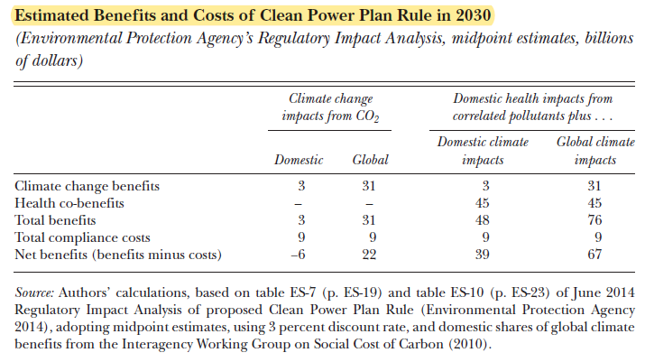
An Environmental Economics Example – Part 1
In 2015, the US EPA proposed the Clean Power Plan.
Significantly reduce electricity generation with coal.
The regulatory impact assessment for the rule → $67 billion in net benefits.
Benefits included “co-pollutants” and global climate damages.
Source: Schmalensee and Stavins (2019).

Slide 21
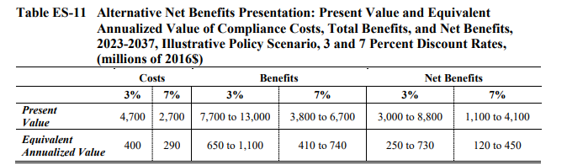
An Environmental Economics Example – Part 2
In 2019, the US EPA proposed the Affordable Clean Energy rule (ACE).
Repeals the Clean Power Plan, implements other changes to power sector and Clean Air Act.
“Restores rule of law, empowers states, and supports energy diversity.”
The RIA: replacing the CPP with ACE “would result in $3.4 billion in net benefits... and avoided compliance costs of $6.4 billion.”
Source: EPA (2019)

Slide 22
Part 3: Readings

Slide 23
Quality Science for Quality Decisions: Protecting the Scientific Integrity of Benefit–Cost Analysis (here)
By: Dr. Al McGartland (US EPA)
Article outline:
Light history of BCA in environmental policy
Role of BCA in decision-making and successes of BCA
How BCA can be undermined by normative considerations
Some solutions to protect scientific integrity

Slide 24
Quality Science for Quality Decisions: Protecting the Scientific Integrity of Benefit–Cost Analysis (here)
By: Dr. Al McGartland (US EPA)
Abstract: Benefit–cost analysis (BCA) provides important science to inform regulatory decision-making. Ideally, the BCA should be based on science, including economics. However, the prominent role of BCA in the policy-making process also creates an incentive to adopt practices that produce results that support a preferred policy. Indeed, rather than informing decision-making, BCA can become a tool for justifying a decision that is made by manipulating results in ways contrary to good science. This article identifies two challenges that threaten the scientific integrity of a BCA because they allow normative and policy judgments to enter into the BCA. The article concludes by identifying actions to help protect the scientific integrity of BCA.

Slide 25

Quick Aside
All significant regulations are required to have benefit cost analyses due to an executive order signed by Ronald Reagan and refined by later presidents.
Ronald Reagan. Image source.

Slide 26
The Value of BCA in Decision-Making
The article lists many ways in which benefit cost analysis had a positive impact on society by informing environmental policymakers:
Setting regulatory priorities based on rules with the greatest net benefits
Identifying and promoting least-cost policy instruments
Causal epidemiology and health impacts studies
Improving accuracy of regulatory analysis by incorporating risk, uncertainty, existence value, human health risk valuation, climate damages, etc.
Improving transparency and accountability surrounding government decisions

Slide 27
Quality Science for Quality Decisions: Protecting the Scientific Integrity of Benefit–Cost Analysis (here)
By: Dr. Al McGartland (US EPA)
Abstract: Benefit–cost analysis (BCA) provides important science to inform regulatory decision-making. Ideally, the BCA should be based on science, including economics. However, the prominent role of BCA in the policy-making process also creates an incentive to adopt practices that produce results that support a preferred policy. Indeed, rather than informing decision-making, BCA can become a tool for justifying a decision that is made by manipulating results in ways contrary to good science. This article identifies two challenges that threaten the scientific integrity of a BCA because they allow normative and policy judgments to enter into the BCA. The article concludes by identifying actions to help protect the scientific integrity of BCA.

Slide 28
How Is BCA Influenced by Normative Considerations?
The article describes many ways in which the credibility of BCA is undermined by normative and/or political considerations:
Embedded science policy:
Reference doses
Pre-set dose-response functional forms
Upper-bound estimates of health damages for margin of safety
Defining the extent of risk assessed (water, air, ingestion pathways)
Requirements on weight of evidence

Slide 29
How Is BCA Influenced by Normative Considerations?
The article describes many ways in which the credibility of BCA is undermined by normative and/or political considerations:
Disregarding theory underlying BCA:
Kaldor Hicks tests are based on consumer sovereignty and market willingness to pay (WTP). WTP (or health cost avoidance) is often observable.
Altering observable WTP or using other metrics is a slippery slope:
“Decision makers can and do weigh benefits in ways that differ from the approach used in BCA.”
Decision makers will choose what benefits or costs should be included.

Slide 30
Quality Science for Quality Decisions: Protecting the Scientific Integrity of Benefit–Cost Analysis (here)
By: Dr. Al McGartland (US EPA)
Abstract: Benefit–cost analysis (BCA) provides important science to inform regulatory decision-making. Ideally, the BCA should be based on science, including economics. However, the prominent role of BCA in the policy-making process also creates an incentive to adopt practices that produce results that support a preferred policy. Indeed, rather than informing decision-making, BCA can become a tool for justifying a decision that is made by manipulating results in ways contrary to good science. This article identifies two challenges that threaten the scientific integrity of a BCA because they allow normative and policy judgments to enter into the BCA. The article concludes by identifying actions to help protect the scientific integrity of BCA.

Slide 31
Actions to Improve Scientific Integrity of BCA
A few ways that BCA can be protected from political interference:
Separate assessment of distributional impacts and environmental justice.
“Trying to address both efficiency and distributional justice issues within one framework shortchanges both issues.”
There are no clear guidelines on whether a specific benefit category should be quantified except the Kaldor-Hicks criterion.
KHC suggests quantifying if there is WTP
Even if WTP relates to uncertain health effects.
Provides a basis for what should be included that is less guided by normative opinion.

Slide 32
Efficiently Unequal: The Global Rise of Kaldor-Hicks Neoliberalism (here)
By: Dr. Eli Cook
Article outline:
Application of Kaldor-Hicks for policy analysis may harm certain groups more than others
Ex: “billion dollar hydropower projects and indigenous groups”
History of the Kaldor-Hicks criterion’s development
Limitations of WTP criterion

Slide 33
History of the Kaldor-Hicks Criterion
Kaldor-Hicks was an outgrowth of the Pareto optimality.
Economics provides a way to value different policies, but not a positive way to specifically recommend different choices through Pareto alone.
KH provides a solution that avoids tricky political discussions. The winners from a policy need not compensate losers. It is sufficient to show that society in aggregate will see greater benefits.
No need to aggregate across subjective utilities.

Slide 34
Limitations of the Kaldor-Hicks Criterion
Cook identifies some issues with the Kaldor-Hicks criterion:
WTP is inherently biased in favor of individuals who can pay more.
Marginalized the distributional aspects of economic decision-making, and when applied carelessly can legitimize worsening inequality.
The possibility of re-distribution to compensate the losers of a policy is generally not realized.
“Yet despite what many of these practitioners are taught, the Kaldor-Hicks star around which so many regulatory and policy decisions now orbit is not a value neutral or objective methodology but rather, as seen in the Panamanian example above, a powerful – and yet oft-overlooked – intellectual engine of global inequality.”

Slide 35
Efficiently Unequal: The Global Rise of Kaldor-Hicks Neoliberalism (here)
By: Dr. Eli Cook
Ex: The net benefit of saving the Asian elephant (Bandara and Tisdell 2004)
Elephants are destructive and sometimes deadly to rural populations in Sri Lanka
Research question: Is the urban residents’ WTP for the conservation of elephants sufficient to compensate farmers for the damage caused by elephants?
Yes. “…there is a strong economic case for the conservation of the wild elephant population in Sri Lanka.”

Slide 36
Positive and Normative: Take-Aways
Some take-aways:
Economics can be used to provide valuable positive and quantitative information to decision-makers.
In practice, it is nearly impossible to separate positive determinations from normative assertions and assumptions.
Economists can better inform the public and decision-makers by:
Being transparent about the implications of their assumptions,
Understanding and explicitly grappling with the normative context that shapes economic analysis and environmental problems.

Slide 37
Reminders
Case Study 2: Climate Economics is Due Sunday, October 1st, by 11:59PM!
Readings for next Monday, October 2nd:
Arrow et al. (1996)
Fraas et al. (2023)
(optional) Flyvberg and Bester (2021)

